Slide 1
FUNDAMENTALS
OF
MACHINE LEARNING
Unit– III
Modeling and Evaluation
Prepared by: Jhankhana S. Koshti

Slide 2
3.1.1 Selecting a Model
Predictive/Descriptive
3.2.1 Training a Model for supervised learning:
Holdout method
K-fold Cross-validation method
3.3.1 Model representation and interpretability
3.3.2 Evaluating performance of a model
Confusion Matrix
3.3.3 Improving Performance of a model

Slide 3
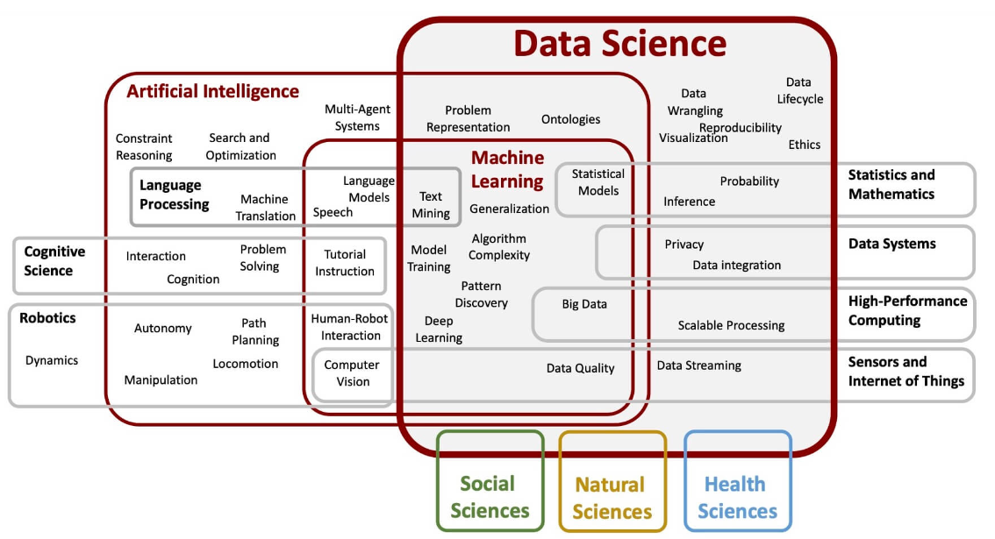

Slide 4
Learning
Evaluation
Hypothesis
Statistics
Prediction
Training
Probability
Machine Learning
Modeling
KNN
Statistics
Regression
Classification
Algorithms
Problem Solving

Slide 5
Machine Learning
Machine learning is a series of algorithms with set objective and without being explicitly programmed. It performs well in development of prediction model and has been widely used in medical data in recent years.

Slide 6
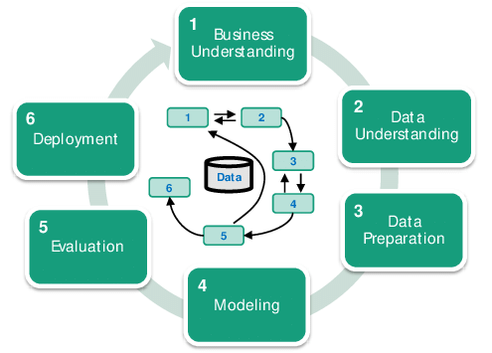

Slide 7
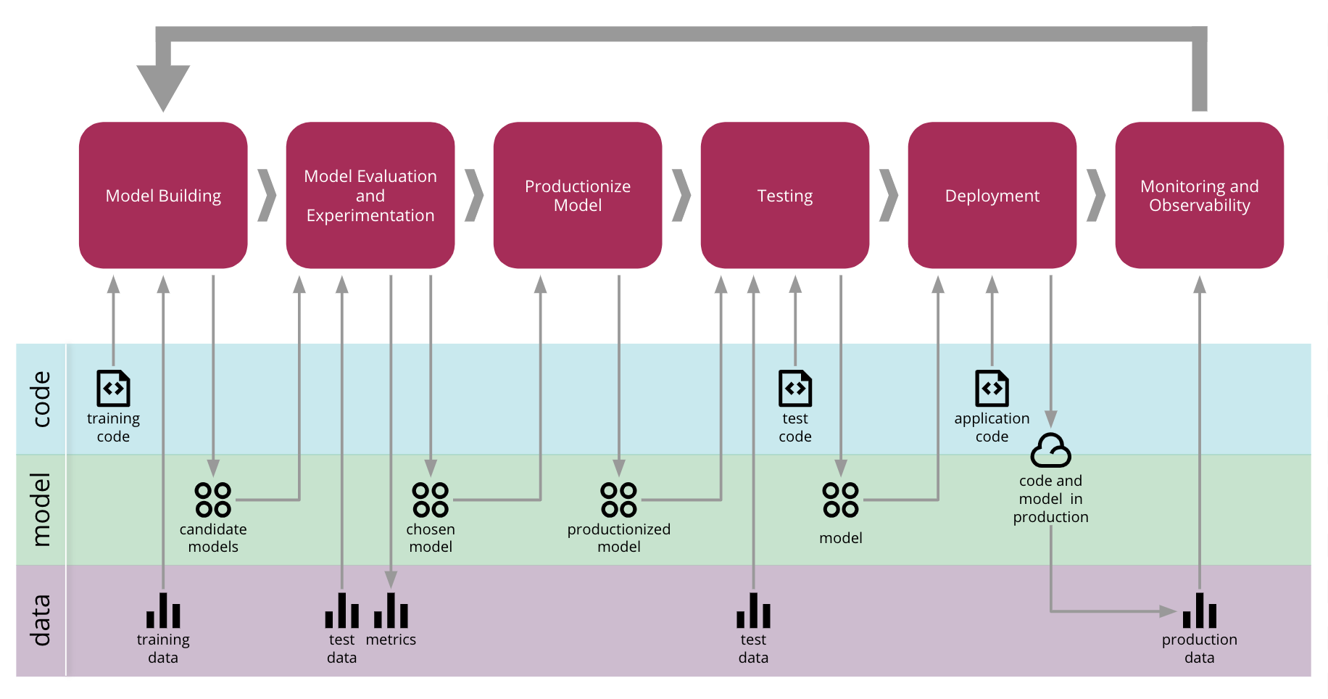

Slide 8
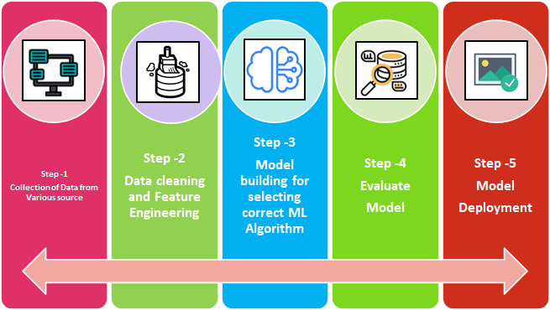

Slide 9
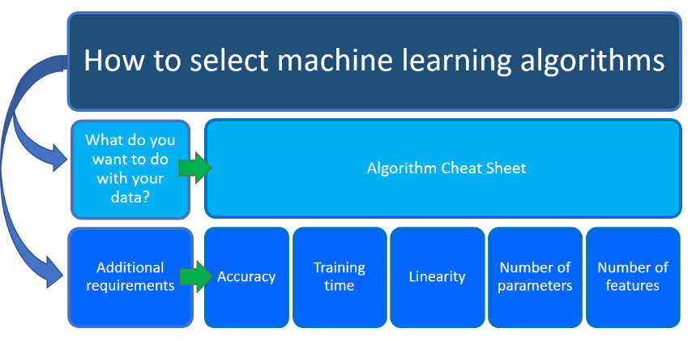
“We could say that the MODEL have to train such a way to Learn, but not to Memorize

Slide 10
3.1.1 Selecting a Model
The challenge of applied machine learning, therefore, becomes how to choose among a range of different models that you can use for your problem.
Model selection is the process of choosing one among many candidate models for a predictive modeling problem.
There may be many competing concerns when performing model selection beyond model performance, such as complexity, maintainability, and available resources.
Three points to consider:
What Is Model Selection
Considerations for Model Selection
Model Selection Techniques

Slide 11
What Is Model Selection
Model selection is the process of selecting one final machine learning model from among a collection of candidate machine learning models for a training dataset.
Always selection is the process of selecting the best one by comparing and validating with various parameters and choosing the final one. So in machine learning as well the model selection is not an exceptional case either way!
In Data Science and ML world, this is coming under the collection of available algorithms under different names, purposes, nature of the data. After applied on the training dataset, followed by selecting the BEST ONE and promoting the same model into the PRODUCTION for the live/streaming dataset and monitoring the outcome. And on top make sure the best results and sustaining with the same model for new data for regression, classification and clustering problem statements.

Slide 12
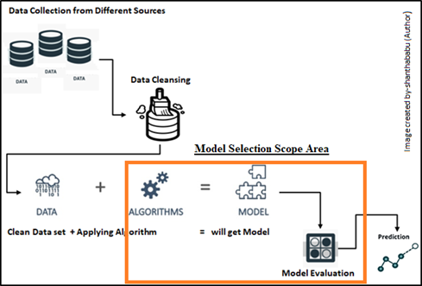

Slide 13
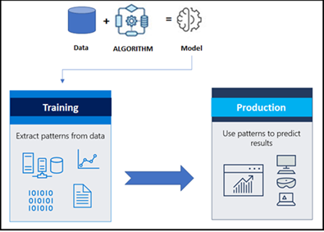
The bottom line is
“We have to compare the relative performance between more than two models
for the given and cleaned data set”
The model should be very flexible and fit into the data and explain the insight of the data in statistical estimation form.
During the model selection, we are supposed to get ready with the required sufficient data in hand. In an ideal situation, we have to split the data into three different sets of data
Training set
Used to fit the models
Validation set
Used to Estimate the prediction of error for the model
Test set
Used for Assessment of the Generalization error
Once all the above process flow has been completed the final model could be select from the list of models.

Slide 14
3.1.1 Selecting a Model (Predictive/Descriptive)

Slide 15
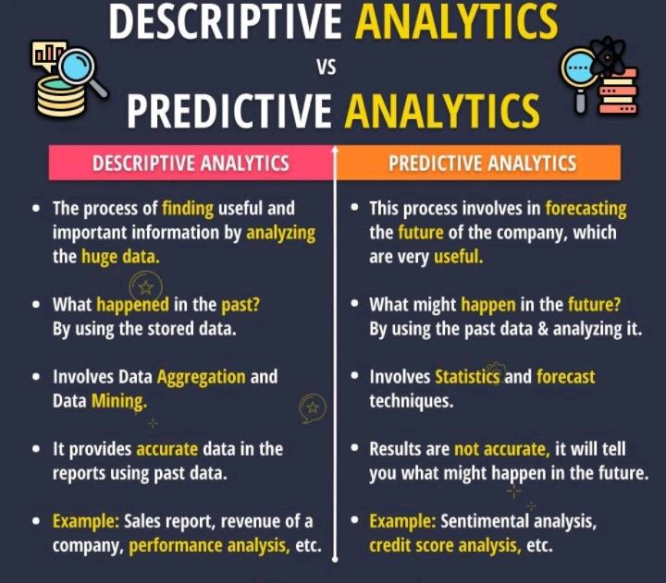

Slide 16
3.2.1 Training a Model for supervised learning:
● Holdout method
● K-fold Cross-validation method

Slide 17
Hold Out Method

Slide 18
Holdout Method is the simplest sort of method to evaluate a classifier. In this method, the data set (a collection of data items or examples) is separated into two sets, called the Training set and Test set.
A classifier performs function of assigning data items in a given collection to a target category or class

Slide 19
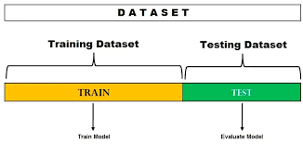

Slide 20
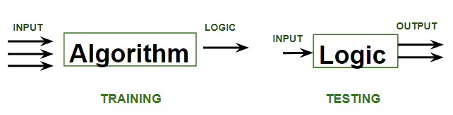

Slide 21


Slide 22
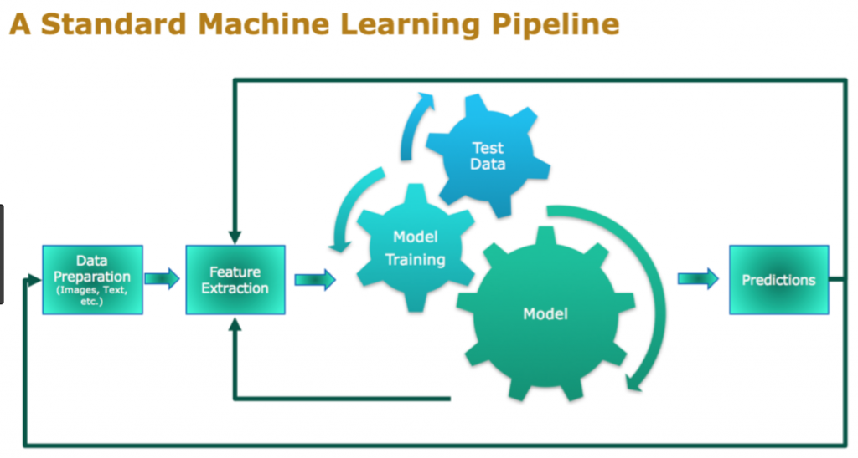

Slide 23
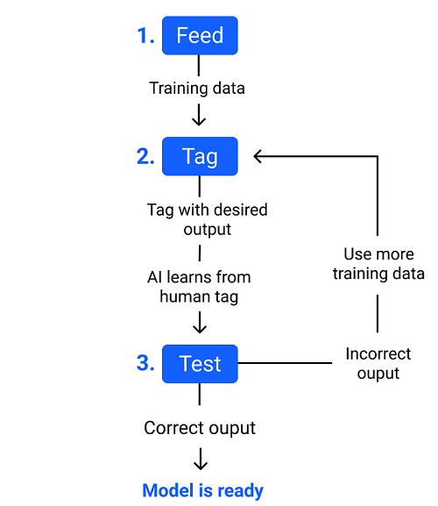

Slide 24
Example
E-mails in our inbox being classified into spam and non-spam.
Classifier should be evaluated to find out, it’s accuracy, error rate, and error estimates. It can be done using various methods. One of most primitive methods in evaluation of classifier is ‘Holdout Method’.
In the holdout method, data set is partitioned, such that – maximum data belongs to training set and remaining data belongs to test set.

Slide 25
Example
If there are 20 data items present, 12 are placed in training set and remaining 8 are placed in test set.
After partitioning data set into two sets, training set is used to build a model/classifier.
After construction of classifier, we use data items in test set, to test accuracy, error rate and error estimate of model/classifier.
However, it is vital to remember two statements with regard to holdout method. These are :
If maximum possible data items are placed in training set for construction of model/classifier, classifier’s error rates and estimates would be very low and accuracy would be high. This is sign of a good classifier/model.

Slide 26
Example
A student ‘gfg’ is coached by a teacher. Teacher teaches her all possible topics which might appear for exam. Hence, she tends to commit very less mistakes in exam, thus performing well.
If more training data are used to construct a classifier, it qualifies any data used from test set, to test it (classifier).
If more number of data items are present in test set, such that they are used to test classifier built using training set. We can observe more accurate evaluation of classifier with respect to it’s accuracy, error rate and estimation.

Slide 27
Problem
During partitioning of whole data set into 2 parts i.e., training set and test set, if all data items belonging to class – GFG1, are placed in test set entirely, such that none of data items of class GFG1 are in training set. It is evident, that model/classifier built, is not trained using data items of class – GFG1.

Slide 28
Solution :
Stratification is a technique, using which data items belonging to class – GFG1 are divided and placed into two data sets i.e training set and test set, equally. Such that, model/classifier is trained by data items belonging to class -GFG1.

Slide 29
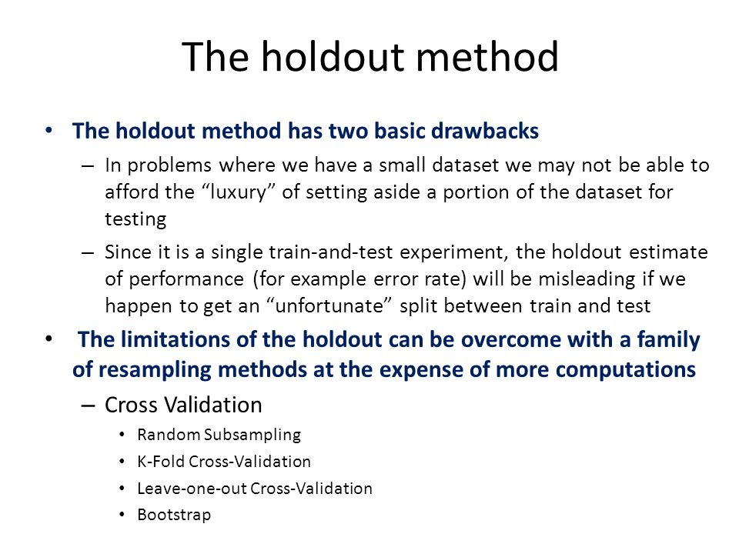

Slide 30
K Fold Cross Validation method
(Repeated Hold out Method)

Slide 31
Repeated Holdout Method is an iteration of the holdout method i.e it is the repeated execution of the holdout method.
This method can be repeated — ‘K’ times/iterations.

Slide 32
In this method, we employ random sampling of the dataset. The dataset is partitioned randomly and not on the basis of any formula.
[Note: Random sampling refers to the selection of ‘n’ individuals from the population, chosen in such a way that every set of ‘n’ individuals has the same chance to be selected. ]

Slide 33
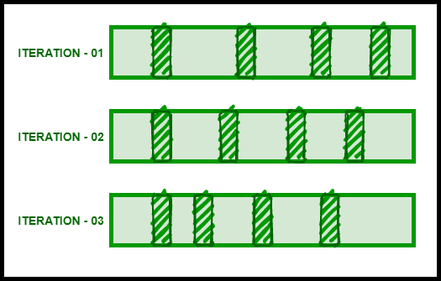
Example – Consider a dataset, which is stratified into the training set and test set, randomly. We repeat the holdout method for ‘K’ iterations. Let us assume K=3

Slide 34
The shaded portions in the above iterations are the test sets and the unshaded portions are the training sets, which are obtained after the stratification of the dataset.
In the first iteration ‘ITERATION – 01’, a classifier is constructed on the basis of the data items/example that belongs to the training set. The classifier after construction is applied to the test set. The result obtained is an error estimate, say ‘E1’.
In the second iteration ‘ITERATION – 02’, the first iteration is randomly arranged. A classifier is now constructed on the basis of training set data items/examples. The classifier after construction is applied to the test set. The result obtained is an error estimate, say ‘E2’.

Slide 35
In the third iteration ‘ITERATION – 03’, the second iteration is randomly arranged. A classifier is now constructed on the basis of training set data items/examples. The classifier after construction is applied to the test set. The result obtained is an error estimate, say ‘E3’.
The iterations are thus repeated ‘K=3’ times.
To find the overall error estimate, we can use the formula –

Slide 36
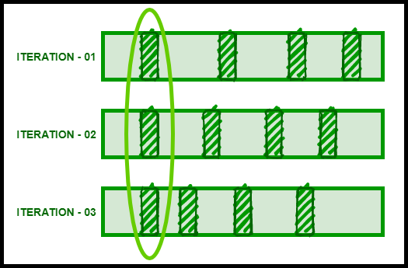
Problem: Overlapping test set problem.
Since we partition the dataset randomly into a training set and test set, there are some data items/examples that could not be placed in the training set at all
Example –

Slide 37
3.3.1 Model representation
and
interpretability

Slide 38
The main goal of each machine learning model is to generalize well.
Here generalization defines the ability of an ML model to provide a suitable output by adapting the given set of unknown input.
It means after providing training on the dataset, it can produce reliable and accurate output.
Hence, the underfitting and overfitting are the two terms that need to be checked for the performance of the model and whether the model is generalizing well or not.

Slide 39
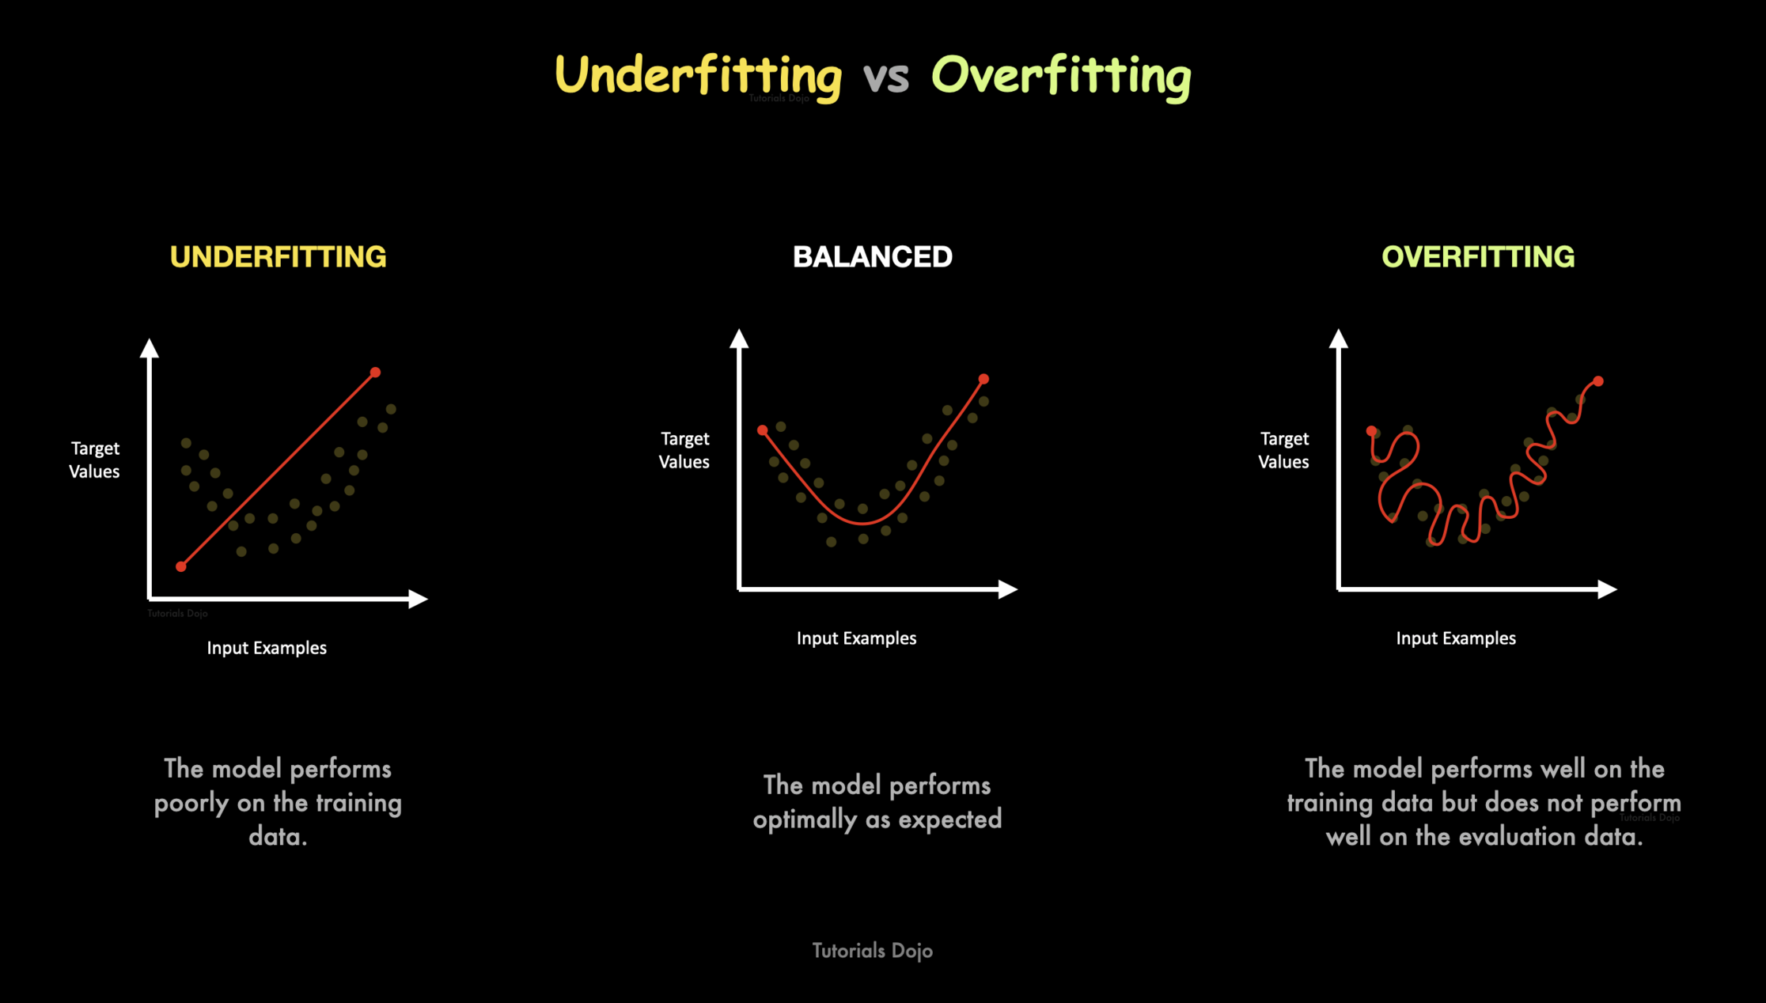

Slide 40
Underfitting
A statistical model or a machine learning algorithm is said to have underfitting when it cannot capture the underlying trend of the data, i.e., it only performs well on training data but performs poorly on testing data.
Reasons for Underfitting:
High bias and low variance
The size of the training dataset used is not enough.
The model is too simple.
Training data is not cleaned and also contains noise in it.
Techniques to reduce underfitting:
Increase model complexity
Increase the number of features, performing feature engineering
Remove noise from the data.
Increase the number of epochs or increase the duration of training to get better results.

Slide 41
Overfitting:
A statistical model is said to be overfitted when the model does not make accurate predictions on testing data. When a model gets trained with so much data, it starts learning from the noise and inaccurate data entries in our data set.
Reasons for Overfitting are as follows:
High variance and low bias
The model is too complex
The size of the training data
Techniques to reduce overfitting:
Increase training data.
Reduce model complexity.
Early stopping during the training phase (have an eye over the loss over the training period as soon as loss begins to increase stop training).
Ridge Regularization and Lasso Regularization
Use dropout for neural networks to tackle overfitting.

Slide 42
Good Fit in a Statistical Model:
Ideally, the case when the model makes the predictions with 0 error, is said to have a good fit on the data. This situation is achievable at a spot between overfitting and underfitting. In order to understand it, we will have to look at the performance of our model with the passage of time, while it is learning from the training dataset.

Slide 43
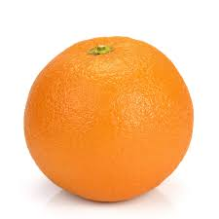
Ball
Attributes
Sphere
Play
Eat
Radius
Ball

Slide 44
Bias: Assumptions made by a model to make a function easier to learn. It is actually the error rate of the training data. When the error rate has a high value, we call it High Bias and when the error rate has a low value, we call it low Bias.
Variance: The difference between the error rate of training data and testing data is called variance. If the difference is high then it’s called high variance and when the difference of errors is low then it’s called low variance. Usually, we want to make a low variance for generalized our model.

Slide 45
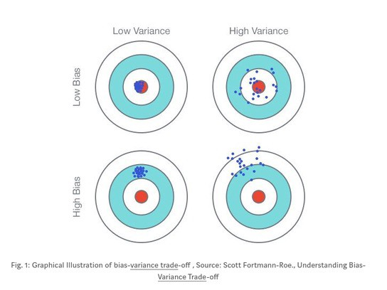

Slide 46
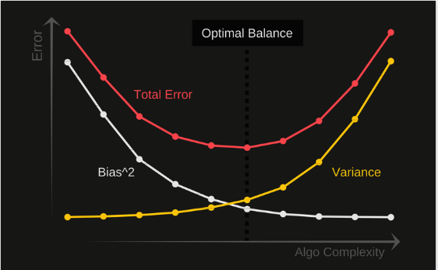
Bias Variance Trade-off

Slide 47
3.3.2 Evaluating performance of a model
• Confusion Matrix

Slide 48
What is a Confusion Matrix?
A confusion matrix, also known as an error matrix, is a summarized table used to assess the performance of a classification model. The number of correct and incorrect predictions are summarized with count values and broken down by each class.

Slide 49
For Example, let’s say that there were ten instances where a classification model predicted ‘Yes’ in which the actual value was ‘Yes’. Then the number ten would go in the top left corner in the True Positive quadrant. This leads us to some key terms:
Positive (P): Observation is positive (eg. is a dog).
Negative (N): Observation is not positive (eg. is not a dog).
True Positive (TP): Outcome where the model correctly predicts the positive class.
True Negative (TN): Outcome where the model correctly predicts the negative class.
False Positive (FP): Also called a type 1 error, an outcome where the model incorrectly predicts the positive class when it is actually negative.
False Negative (FN): Also called a type 2 error, an outcome where the model incorrectly predicts the negative class when it is actually positive.

Slide 50
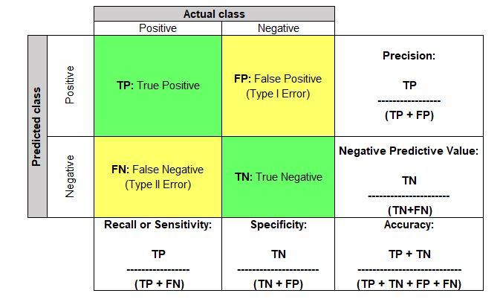

Slide 51
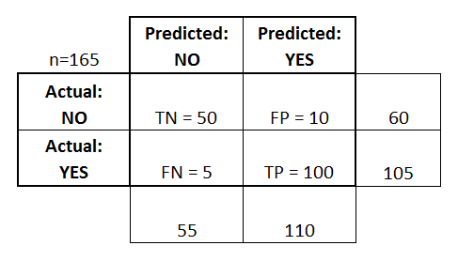
Accuracy:
Overall, how often is the classifier correct?
(TP+TN)/total = (100+50)/165 = 0.91
Misclassification Rate:
Overall, how often is it wrong?
(FP+FN)/total = (10+5)/165 = 0.09
equivalent to 1 minus Accuracy
also known as "Error Rate"
True Positive Rate:
When it's actually yes, how often does it predict yes?
TP/actual yes = 100/105 = 0.95
also known as "Sensitivity" or "Recall“
Precision:
When it predicts yes, how often is it correct?
TP/predicted yes = 100/110 = 0.91

Slide 52
3.3.3 Improving Performance of a model

Slide 53
Model Selection Requirement
Tuning Model Parameter
kNN
Combining several models
Ensemble
Bootstrap Aggregating/ Bagging
Adaptive boosting or AdaBoost

Slide 54
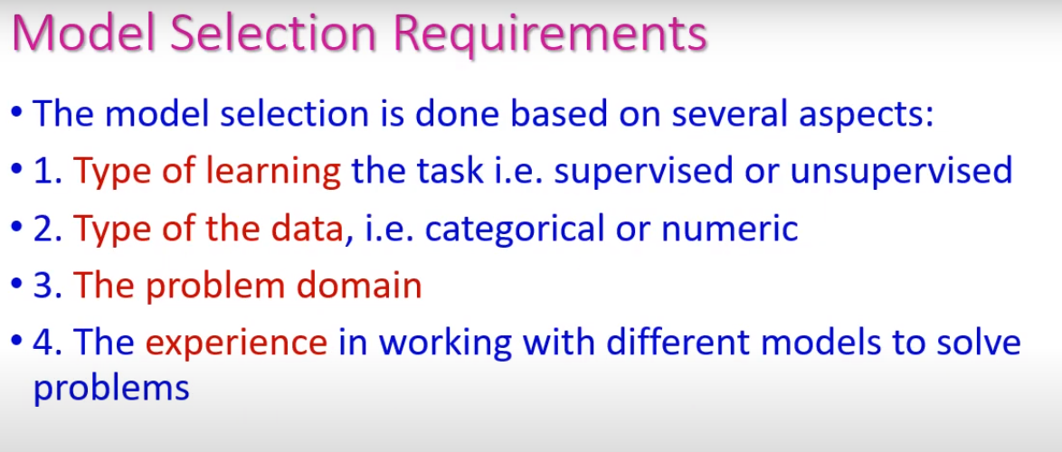

Slide 55
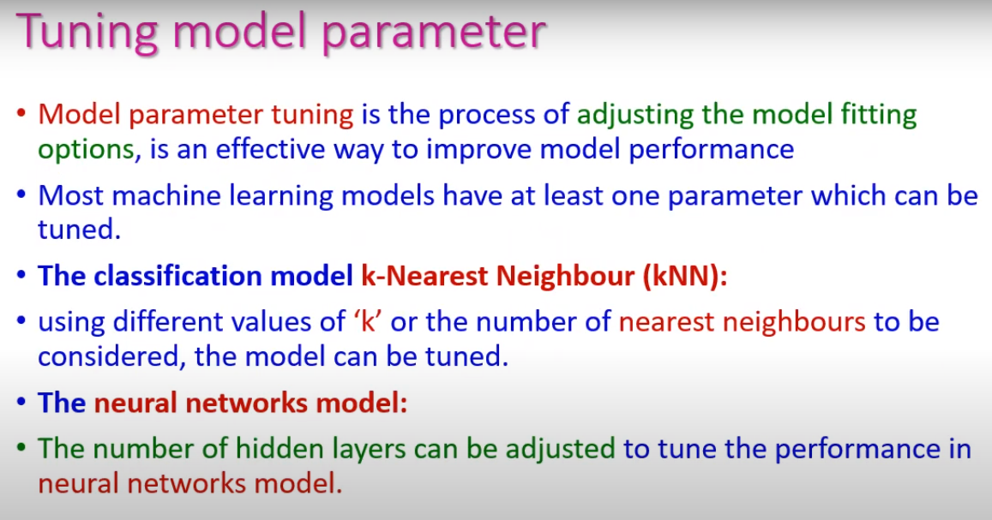

Slide 56
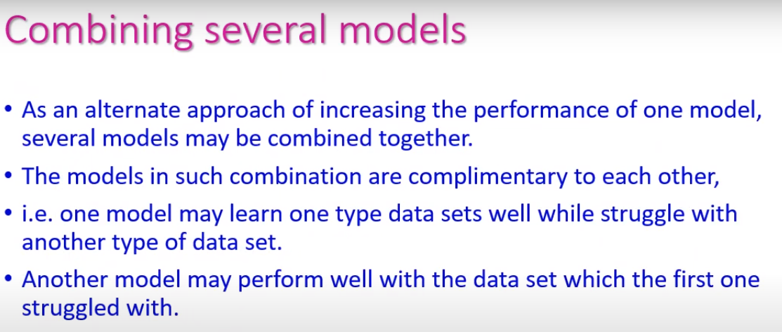

Slide 57
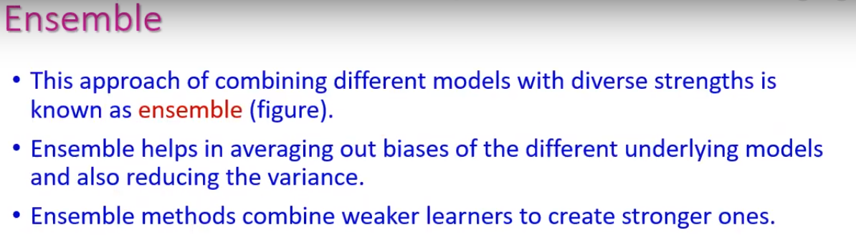
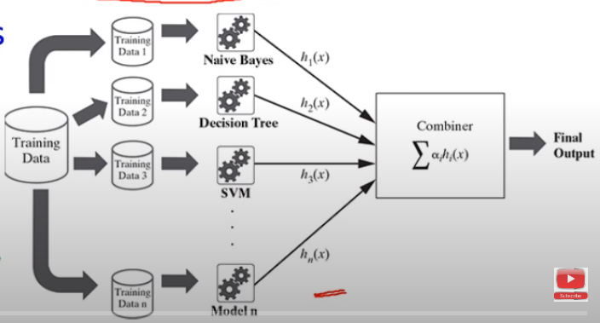

Slide 58
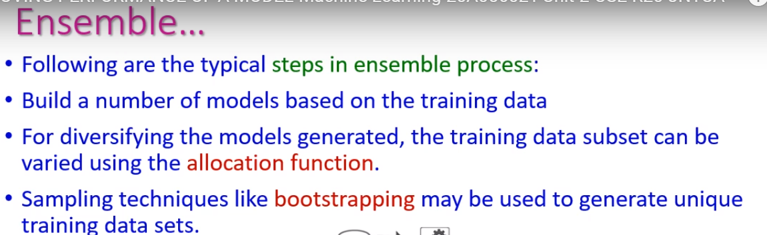

Slide 59
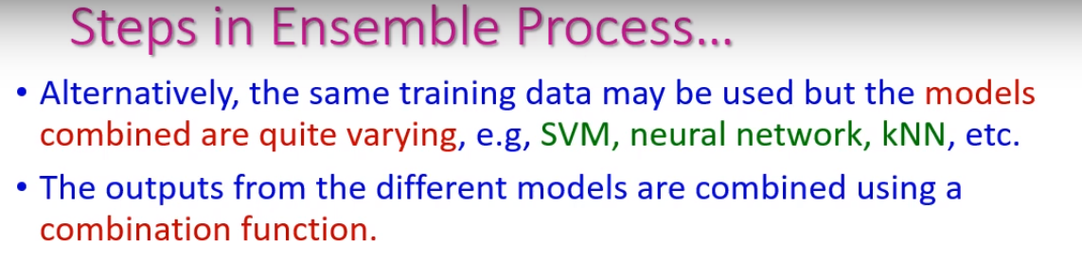
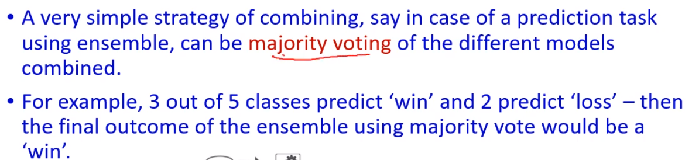

Slide 60
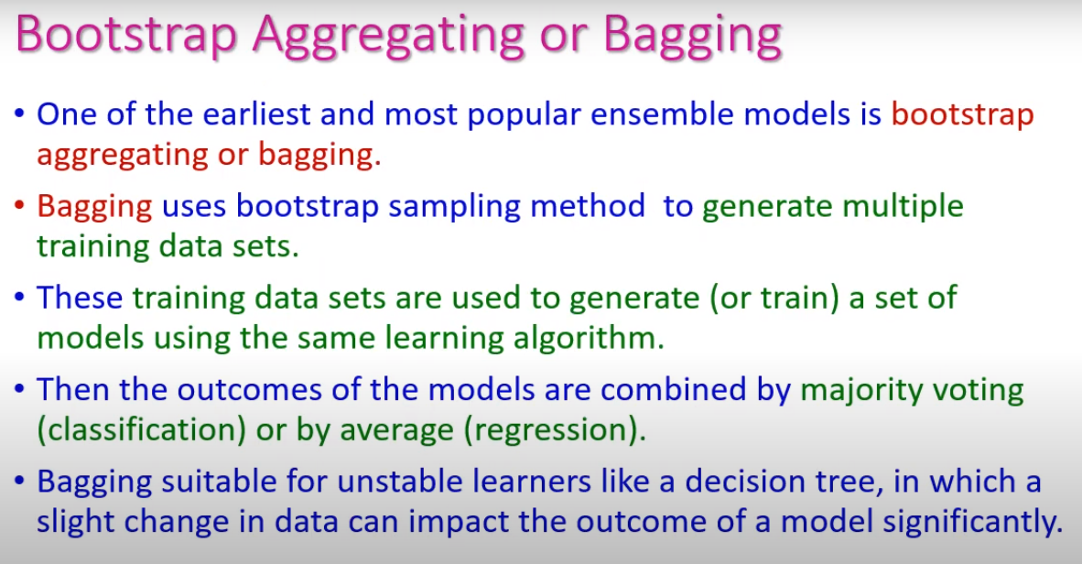

Slide 61
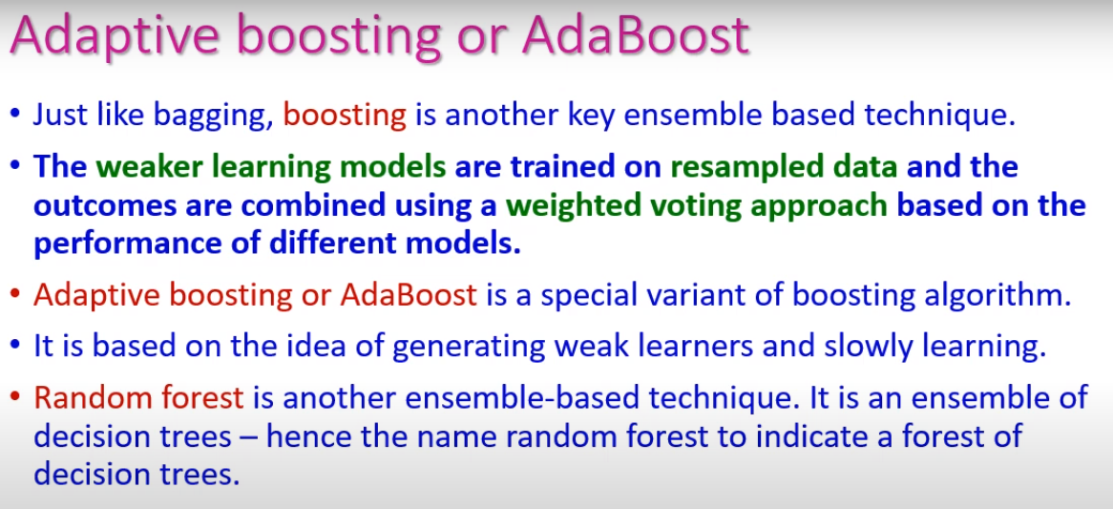

Slide 62
Thank You

